Slide 1
Engineering Bacterial Nanocellulose Suspensions
Our expertise lies in tailoring nanofibril morphology, surface chemistry, and interparticle interactions to control suspension stability and rheological behaviour.

Slide 2
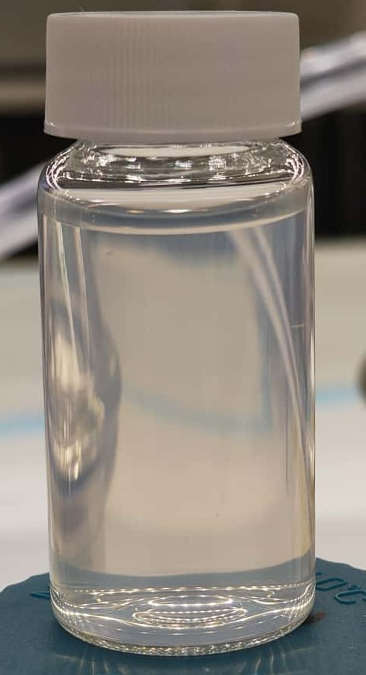
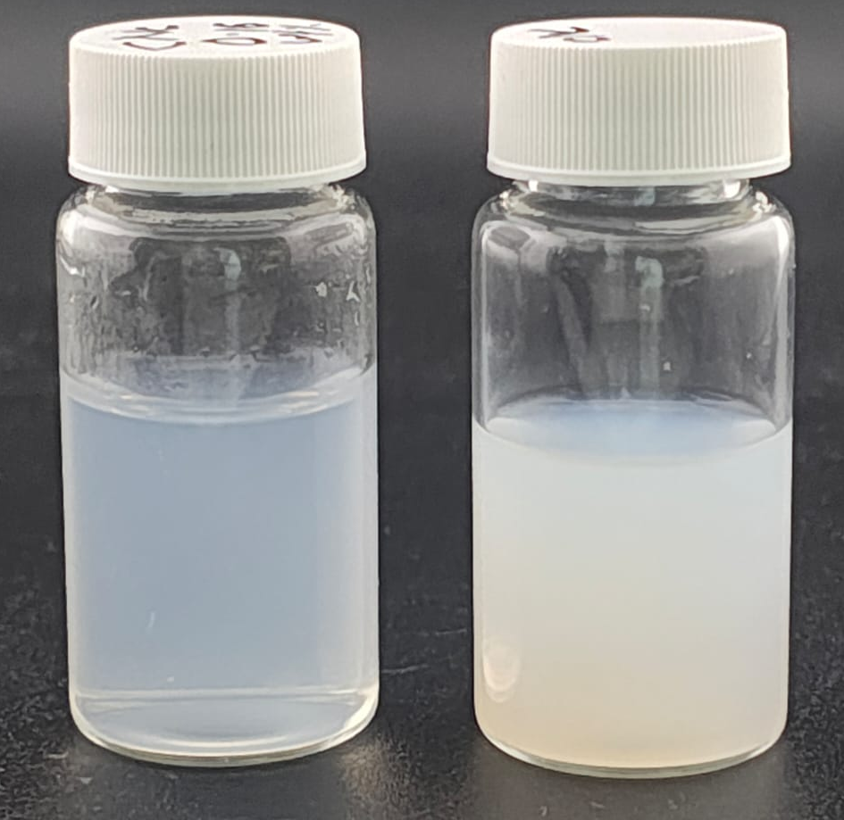
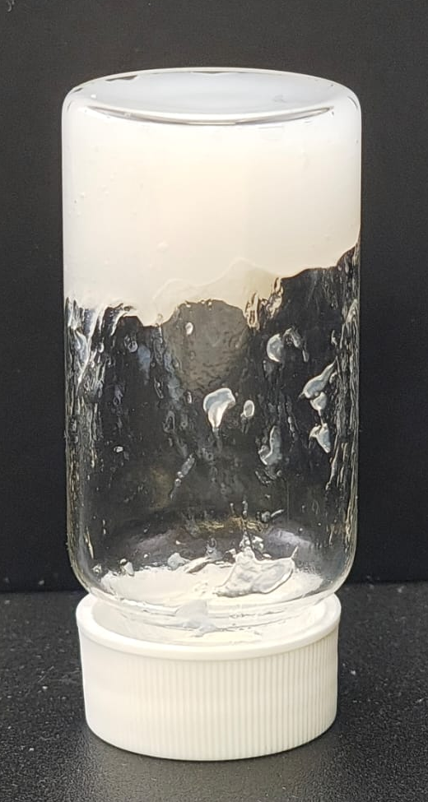
Cellulose Nanocrystals CNCs
Isotropic to ordered Liquid Crystalline Phase
Morphology & surface characteristics
Length: 900 ± 300nm
Width: 25 ± 10 nm
Aspect ratio: 35- 40
ζ-potential: ≈ −34.07 ± 1.25 mV
Mobility (µm·cm/V·s): −2.670 ± 0.097 µm·cm/V·s
Sulfate group content = 218.3 ± 2.1 µmol g⁻¹

Slide 4
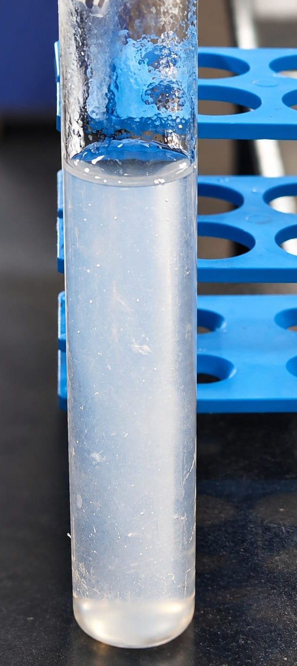
Cellulose nanofibrils CNFs
Long, highly entangled CNFs can remain physically stable through network formation even without strong electrostatic stabilization.
Stable suspension with no phase suspension
Morphology & surface characteristics
Length: >50 µm, extending beyond the SEM field of view
Width: 86.4 ± 40.8 nm
Aspect ratio: >580
ζ-potential: ≈ 0 mV
Surface: Non-functionalised CNFs

Slide 5
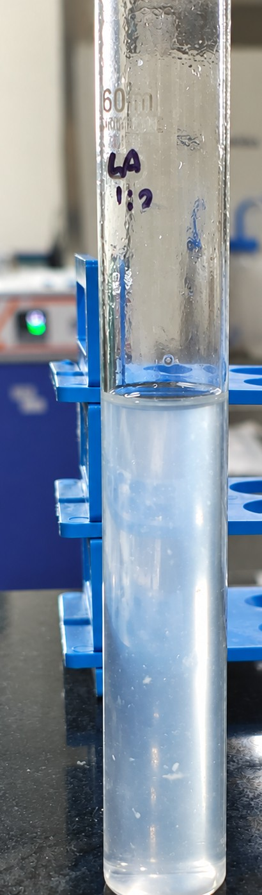
Cellulose nanofibrils CNFs
Morphology & surface characteristics
Length: 5.46 ± 1.21 µm
Width: 30.3 ± 19.2 nm
Aspect ratio: 180
ζ-potential: ≈ -7 mV
Surface: functionalised CNFs

Slide 6
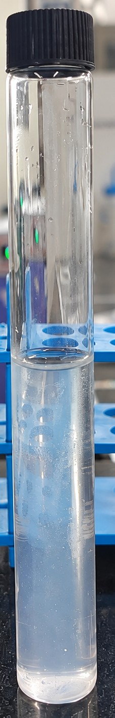
Cellulose nanofibrils CNFs
Morphology & surface characteristics
Length:
Width: 24.7 ± 12.8 nm.
Aspect ratio: 70
ζ-potential: ≈ −23.0 ± 0.4 mV
Surface: functionalised CNFs
1.73 ± 0.32 µm

Slide 7
Nanofibrils with varying aspect ratios and network behavior
CNFs
CNCs

Slide 8
Nanofibrils with varying aspect ratios and network behavior
CNF_LA_1_2
CNF_LA_1_9
CNF_OA

